Slide 1
SSIS
Lesson 2. Introduction to Control and Data Flow Tasks

Slide 2
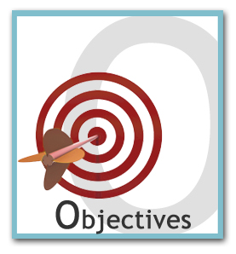
Lesson Objectives
After completing this module you will be able to:
Understand Control Flow Tasks
Control Flow Task Containers
Control Flow Tasks
Precedence
Understand Data Flow Tasks
Data Flow Source
Data Flow Transformations
Data Flow Destination
Event Handler

Slide 3
SSIS Package Task Components
Microsoft SQL Server Integration Services provides various “Task components” for building Integration Services packages
A SSIS Package is the core and self content concept in SSIS solution development.
A package is an organized collection of connections, control flow elements, data flow elements, event handlers, variables, and configurations, that you assemble using the graphical design tools that SQL Server Integration Services provides
A SSIS package can have
Control Flow
Data Flow
Event Handlers
SSIS package designer surface has a tab for each one of above
Notes:
Package Content
A control flow consists of one or more tasks and containers that execute when the package runs. To control order or define the conditions for running the next task or container in the package control flow, you use precedence constraints to connect the tasks and containers in a package. A subset of tasks and containers can also be grouped and run repeatedly as a unit within the package control flow.
A data flow consists of the sources and destinations that extract and load data, the transformations that modify and extend data, and the paths that link sources, transformations, and destinations. Before you can add a data flow to a package, the package control flow must include a Data Flow task. The Data Flow task is the executable within the SSIS package that creates, orders, and runs the data flow. A separate instance of the data flow engine is opened for each Data Flow task in a package. For more information, see Data Flow Task, Data Flow Elements and Creating Package Data Flow.
A package typically includes at least one connection manager. A connection manager is a link between a package and a data source that defines the connection string for accessing the data that the tasks, transformations, and event handlers in the package use. Integration Services includes connection types for data sources such as text and XML files, relational databases, and Analysis Services databases and projects.

Slide 4
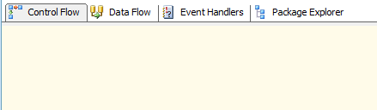
SSIS Package Designer Tabs
Notes:
The SSIS Package Designer
The SSIS Package Designer contains the design panes that you'll use to create a SSIS package. The tool contains all the items you need to move data or create a workflow with minimal or no code. The Package Designer contains four tabs: Control Flow, Data Flow, Event Handlers, and Package Explorer. One additional tab, Progress, also appears when you execute packages. In this chapter, you'll mainly explore the Controller Flow tab. Unlike SQL Server 2000 DTS, where control and data flow were intermingled, control flow and data flow editors are completely separated by these tabs. This usability feature gives you greater control when creating and editing packages. The task that binds the control flow and data flow together is the Data Flow task, which you'll study in depth over the next two chapters.

Slide 5
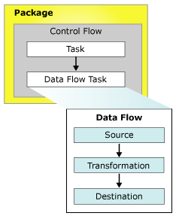
SSIS Package Design
Notes:
The Control Flow is more of Procedural Logic Implementation and about setting up of environment for the ETL to go ahead.
The Data Flow is the actual core ETL implementation initiated from the Control Flow.

Slide 6
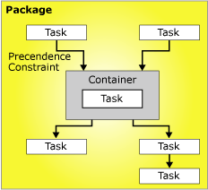
Control Flow Tasks
SQL Server Integration Services provides three different types of control flow elements:
Control Flow Containers: that provide structures in packages
Control Tasks: that provide functionality
Precedence Constraints: that connect the executables, containers, and tasks into an ordered control flow.

Slide 7
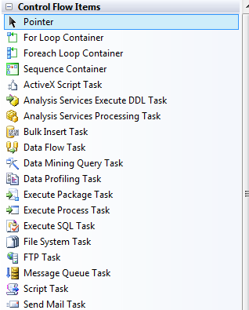
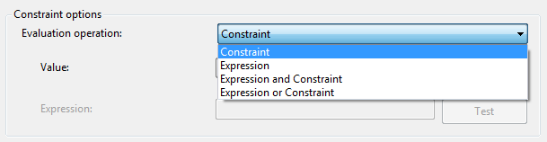
SSIS Package Control Flow Task Components

Slide 8
Control Flow - Containers
Containers provide structure in packages and services to tasks in the control flow.
Integration Services includes the following container types, for grouping tasks and implementing repeating control flows:
For Each Loop container enumerates a collection and repeats its control flow for each member of the collection.
For Loop container repeats its control flow until a specified expression evaluates to False.
Sequence container lets you define a subset of the control flow within a container and to manage tasks and containers as a unit.

Slide 9
For Each Loop Container
For Each ADO enumerator to enumerate rows in tables. For example, you can get the rows in an ADO recordset.
For Each Item enumerator to enumerate items that are collections. For example, you can enumerate the names of executables and working directories that an Execute Process task uses
For Each File enumerator to enumerate files in a folder. The enumerator can traverse subfolders. For example, you can read all the files that have the *.log file name extension in the Windows folder and its subfolders.

Slide 10
For Loop Container
The For Loop container defines a repeating control flow in a package. The loop implementation is similar to the For looping structure in programming languages.
The For Loop container uses the following elements to define the loop:
An optional initialization expression that assigns values to the loop counters.
An evaluation expression that contains the expression used to test whether the loop should stop or continue.
An optional iteration expression that increments or decrements the loop counter.

Slide 11
Sequence Container
Sequence container makes it simple to divide the control flow in a package into groups of tasks that you can manage as a unit
Sequence containers lets you handle the control flow in a package without having to manage individual tasks and containers. For example, you can set the Disable property of the Sequence container to True to disable all the tasks and containers in the Sequence container
If a package has many tasks, it can be helpful to group the tasks in Sequence containers

Slide 12
Control Flow Tasks
Control Tasks are control flow elements that define unit of work that are performed in a package control flow.
If the package contains more than one task, they are connected and sequenced in the control flow by precedence constraints.

Slide 13
Control Flow Tasks
Execute SQL Task: Can execute a SQL statement or a stored procedure against a database.
File System Task: Can copy, delete , move, rename files.
FTP Task: Can upload or download files from or to FTP server.
Send Mail Task: Sends a mail via SMTP server.
Execute Package Task: Can execute or call a child package. It is useful in
Breaking down complex package workflow
Reusing parts of packages

Slide 14
Control Flow Precedence
Precedence constraints link executables, containers, and tasks in packages into a control flow
They specify conditions that determine whether executables run where an executable can be a For Loop, Foreach Loop, or Sequence container; a task;
You can configure precedence constraints in the following ways:
If the precedence constraint uses an execution result, you can specify the execution result to be success, failure, or completion.
If the precedence constraint uses an evaluation result, you can provide an expression that evaluates to a Boolean.
Specify whether the precedence constraint is evaluated singly or together with other constraints that apply to the constrained executable.

Slide 15
Data Flow Tasks
SSIS provides three different types of data flow components:
Sources
Transformations and
Destinations.
Sources extract data from data stores such as tables and views in relational databases, files.
Transformations modify, summarize, and clean data.
Destinations load data into data stores or create in-memory datasets

Slide 16
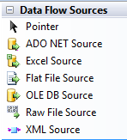
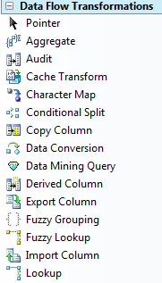
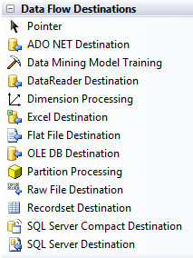
SSIS Package Data Flow Tasks

Slide 17
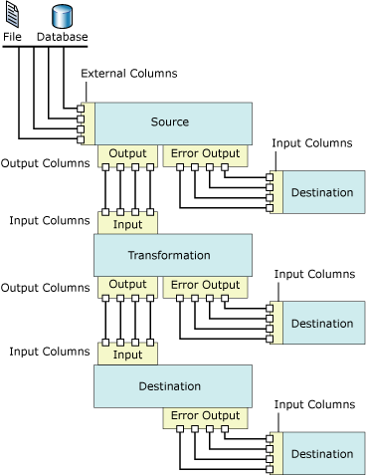
Data Flow Design

Slide 18
Data Flow – Source Tasks
ADO NET source: You configure it by providing the SQL statement that defines the result set. For example, an ADO NET source that connects to the AdventureWorks database and uses the SQL statement SELECT * FROM Production.Product extracts all the rows from the Production.Product table and provides the dataset to a downstream component.
Excel source: Extracts data from worksheets or ranges in Microsoft Excel workbooks.
Flat File source reads data from a text file. The text file can be in delimited, fixed width, or mixed format.

Slide 19
Data Flow – Transformation Tasks
Aggregate Task: Activity such as SUM, AVERAGE etc. are provided by this transformation.
Character Map Task: This transformation takes care of string transformations. A string in a column can be replaced, or a new column can be added with replaced strings.
Conditional Split Task: Routing the data conditionally to outputs, based on a given criteria is sometimes needed.
Copy Column Task: This transformation copies a column to a new column to which you may attach other transformations

Slide 20
Data Flow – Transformation Tasks
Derived Column Task: To create a new column by combining columns, or by applying mathematical expressions to values in columns, or populating a column with a part of data in a column.
Lookup Task: This transformation looks for data in a reference database. It is carried out via EQUIJOINS with the reference database
Fuzzy Lookup Task: This transformation, unlike lookup transformation, uses fuzzy matching. It is not used for locating exact matches, but for locating close matches in the data flow.

Slide 21
Data Flow – Destination Tasks
ADO NET Destination: Loads data into a variety of ADO.NET-compliant databases that use a database table or view.
Excel Destination: Write the data to a Excel Workbook.
OLEDB Destination: Writes data to relational database server using OLE DB providers
SQL Server destination: Inserts data in a sql server database.

Slide 22
Event Handlers
An event handler is a workflow that runs in response to the events raised by a package, task, or container.
For example
you could use an event handler to check disk space when a pre-execution event occurs
send an e-mail message that reports if an error occurs
An event handler is constructed like a package, with a control flow and optional data flows.
Event handlers can be added to individual tasks or containers in the package

Slide 23
Data Flow Transformation Tasks
Aggregate Task:-
Can apply multiple aggregate functions and group by on one or more input columns.
It works in asynchronous fashion.
Export Column Task:-
Reads data in a data flow and inserts the data into a file.
For example, If the data flow contains a picture of each product, you could use the Export Column transformation to save the images to files.
We can specify the data column and the column that contain the path of file to which to write the data.

Slide 24
Data Flow Transformation Tasks
Import Column Task:-
The Import Column Transformation reads data from files and adds that data to columns in a data flow.
Using this transformation, a package can add text and images stored in separate files to a data flow.
For example, a data flow that loads data into a table that stores product information can include the “Import Column” Transformation task to import customer reviews of each product from files and add the reviews to the data flow.
Merge Task:-
The Merge transformation combines two sorted datasets into a single dataset. The rows from each dataset are inserted into the output based on values in their key columns

Slide 25
Data Flow Transformation Tasks
Merge Join Task:-
The Merge Join transformation provides an output that is generated by joining two sorted datasets using a FULL, LEFT, or INNER join.
For example, we can use a LEFT join to join a table that includes product information with a table that lists the country/region in which a product was manufactured. The result is a table that lists all products and their country/region of origin.
Multicast Task:-
The Multicast transformation distributes its input to one or more outputs. Multicast transformation directs every row to every output

Slide 26
Data Flow Transformation Tasks
Oledb Command Task:-
The OLE DB Command transformation runs an SQL statement for each row in a data flow.
The parameter values are stored in external columns in the transformation input, and mapping an input column to an external column maps an input column to a parameter
Percentage Sampling / Row Sampling Tasks:-
Are used to obtain a randomly selected subset of an input dataset. You can specify the size of the output sample , and specify a seed for the random number generator.
Row Count Task:-
Counts rows as they pass through a data flow and stores the final count in a variable

Slide 27
Data Flow Transformation Tasks
Sort Task:-
Sorts input data in ascending or descending order and copies the sorted data to the transformation output
A positive number denotes that the sort is ascending, and a negative number denotes that the sort is descending. Columns that are not sorted have a sort order of 0
The column with the lowest number is sorted first, the sort column with the second lowest number is sorted next

Slide 28
Lesson Summary
From this chapter we learnt:
Understand Control Flow Tasks
Understand Data Flow Tasks
Event Handlers

Slide 29

Review Question
Question 1: ______________ workflow runs in response to the events raised by a package, task, or container.
Question 2: _________, _____________ and ____________ are three different types of data flow components:
Question 3: ____________ container makes it simple to divide the control flow in a package into groups of tasks

